Slide 1
”911 Project"
Harshini Kavuru

Slide 2
Hugging Face Model
The hugging face model is used to obtain key words from the input text.
There are two types of key words obtained from the model:
Chemical
Disease
3. We will add these key-words separately into the already present dataset.
4. Now the dataset will have two additional columns:
Key_words_chemical
Key_words_disease
5. The text that doesn’t have any key_words will have ‘No’ filled in the column.

Slide 3
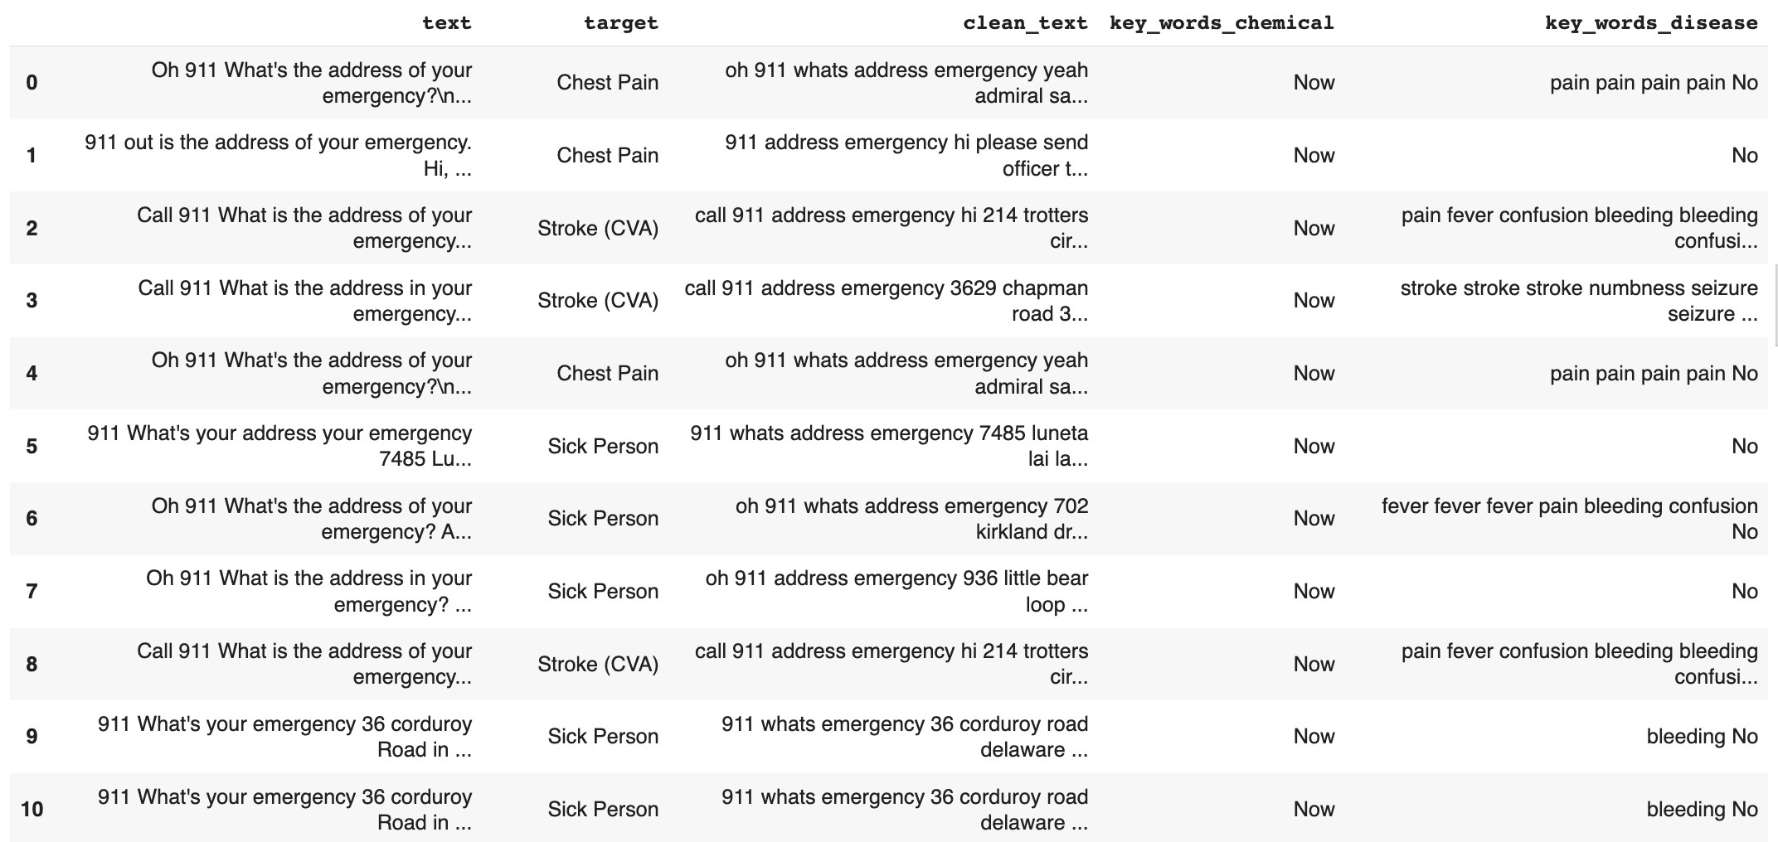
Hugging Face Model

Slide 4
Hugging Face Model
The above dataset is then divided into variables and targets. The variables consists of:
Clean_text
Key_words_chemical
Key_words_disease
2. The target consists of the first impression.
3. The variables are vectorized using the ‘countvectorizer’.
4. This data is used to train the SVM and the NB model.

Slide 5
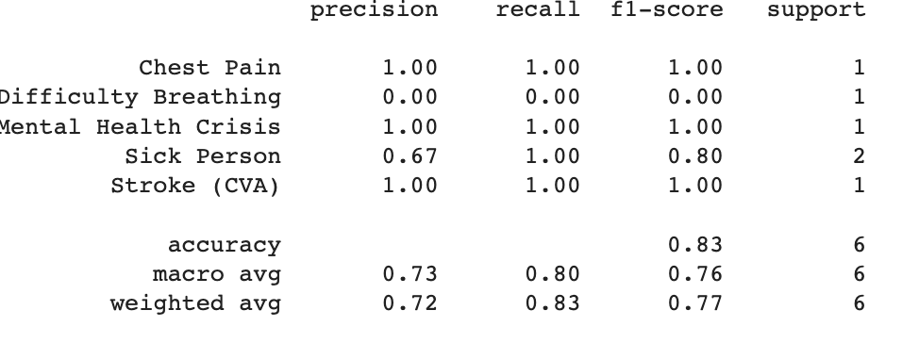
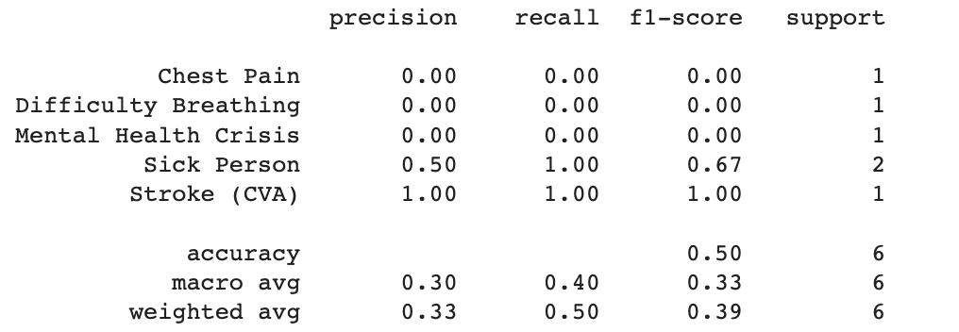
Hugging Face Model
1. SVM and NB output respectively:

Slide 6
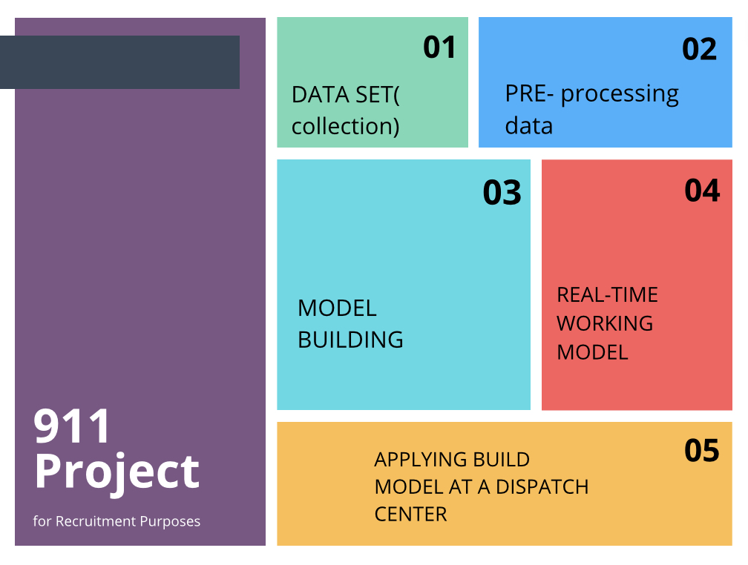
Hugging Face Model

Slide 7
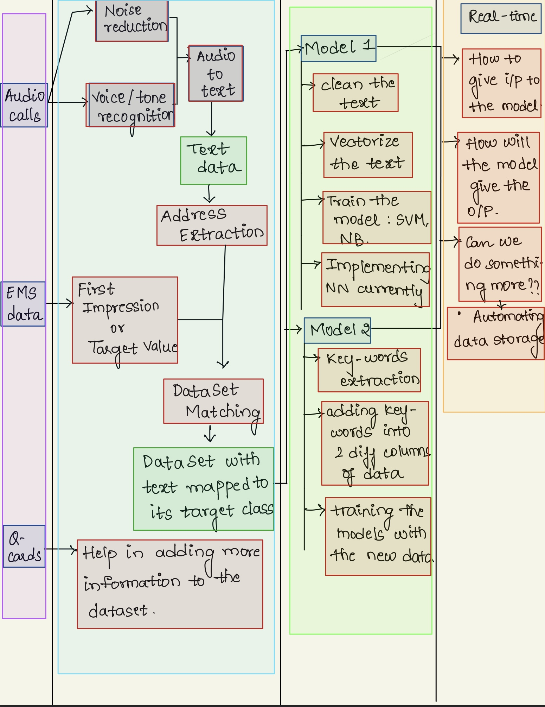
Hugging Face Model

Slide 8
What is Text Analysis for Health
Text Analytics for health now allows extraction of Social Determinants of Health (SDOH) and ethnicity mentions in text.
Text Analytics for health is one of the prebuilt features offered by Azure Cognitive Service for Language.

Slide 9
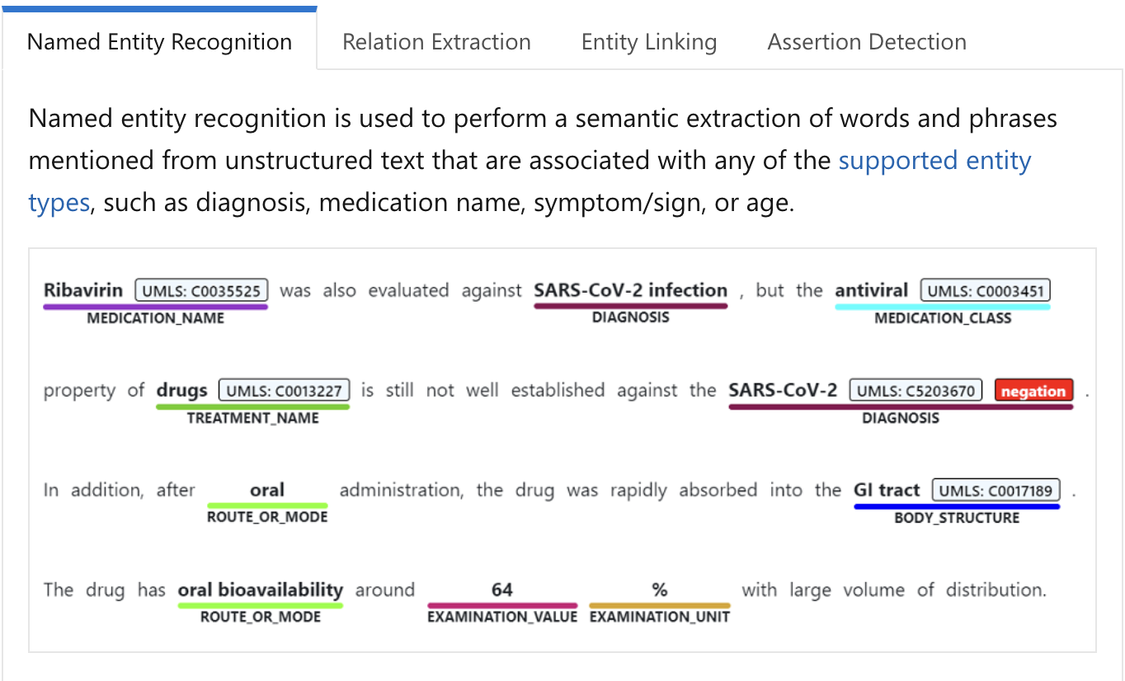
What is Text Analysis for Health

Slide 10
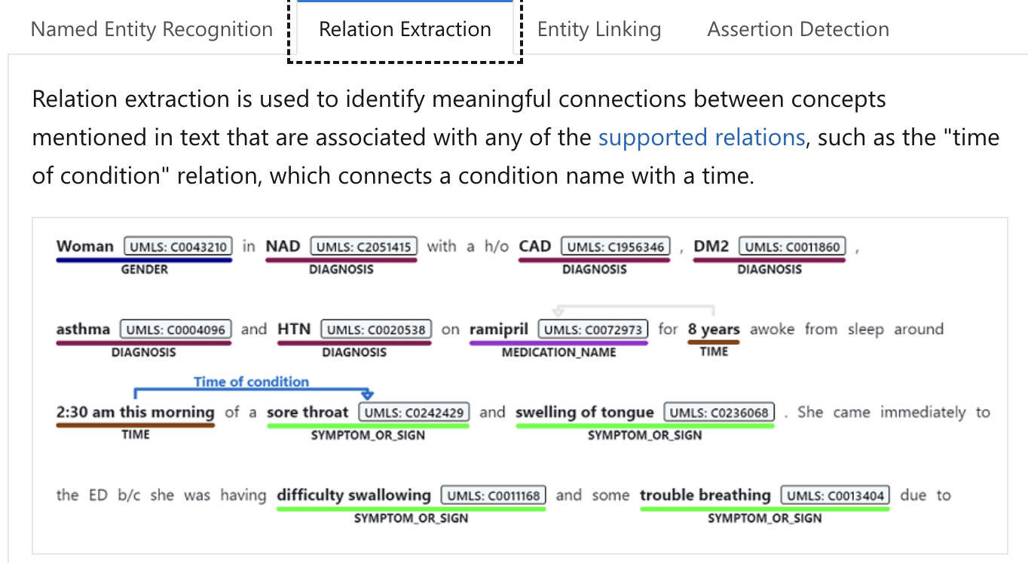
What is Text Analysis for Health

Slide 11
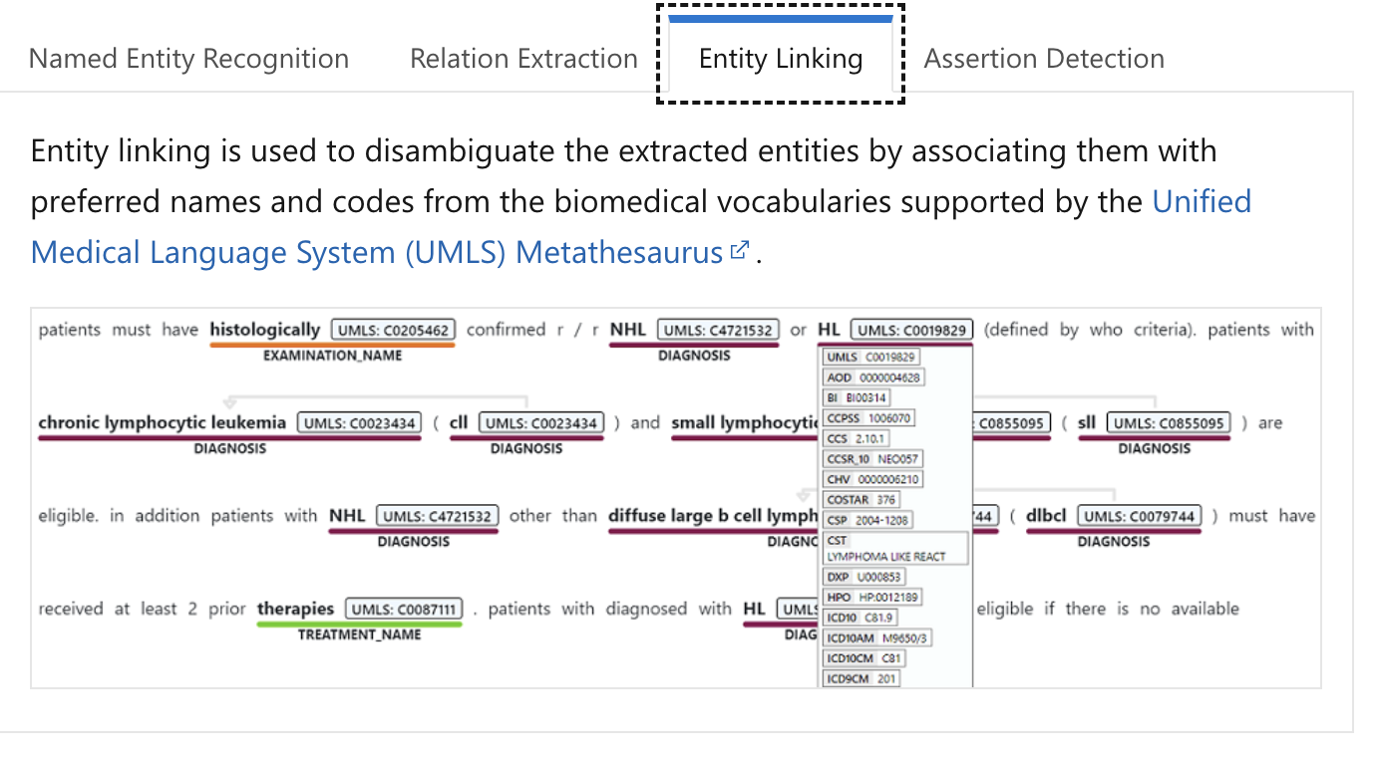
What is Text Analysis for Health

Slide 12
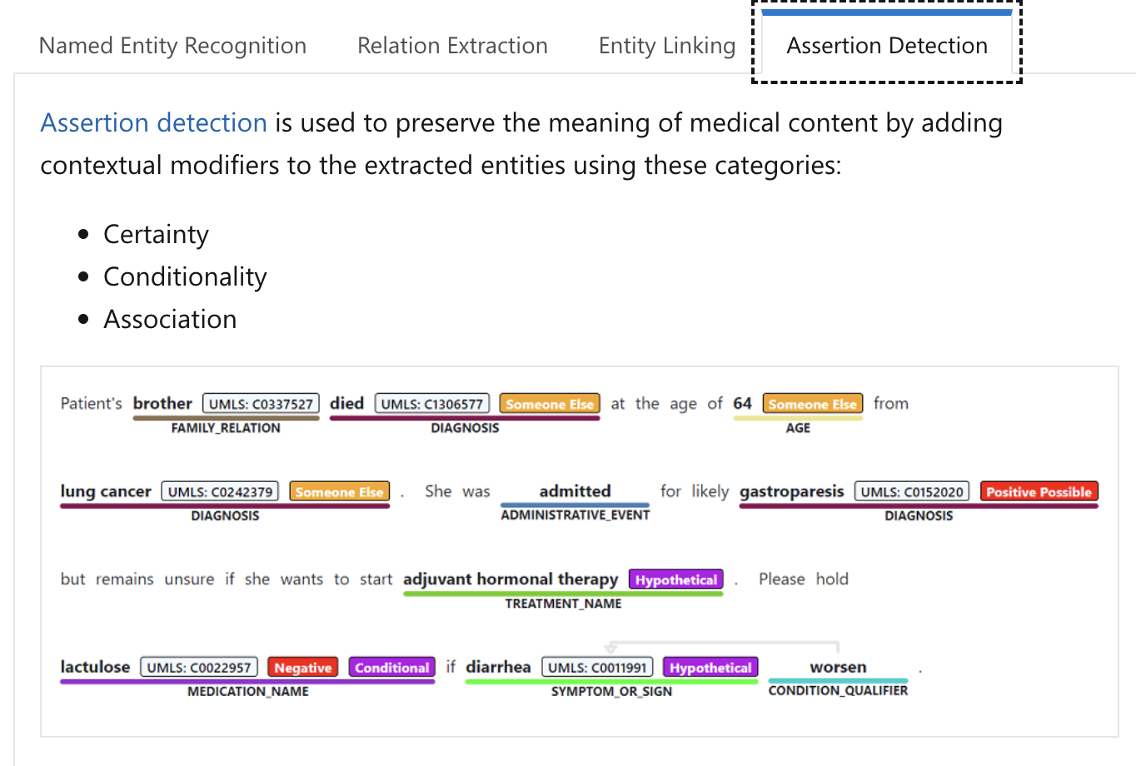
What is Text Analysis for Health

